Slide 1
GROUP-6
Project Name
***********
Barclays Premier League

Slide 2
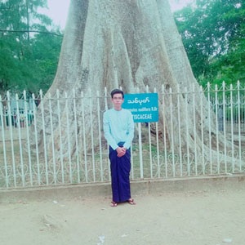
Student Name : Aung Phyo Thu Student ID : 2CS-38

Slide 3
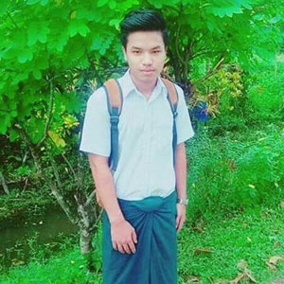
Student Name : Aye Chan Aung Student ID : 2CS-31

Slide 4
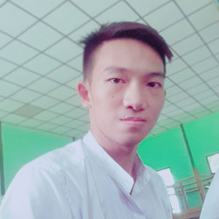
Student Name : Hein Htet Zaw Student ID : 2CS-35

Slide 5
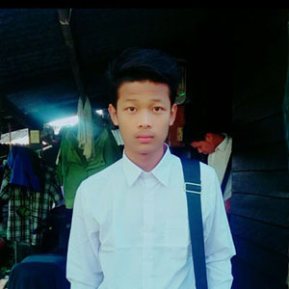
Student Name : Hein Min San Student ID : 2CS-43

Slide 6
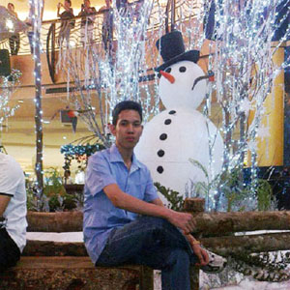
Student Name : Kyaw Kyaw Aung Student ID : 2CS-6

Slide 7
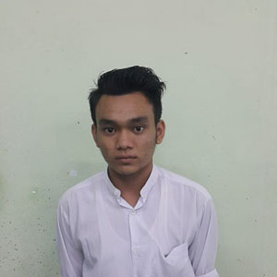
Student Name : Yan Naing Soe Student ID : 2CS-5

Slide 8
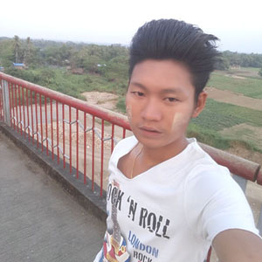
Student Name : Ye Ko Hlaing Student ID : 2CS-41

Slide 9

Student Name : Ye Yint Aung Student ID : 2CS-25

